Slide 1


Design and Development of Advanced Controllers for Interconnection of Microgrids
Presented by
Amit Gupta
PhD @Indian Institute of Technology Bhubaneswar

Slide 2
Introduction and Motivation
Energy Transition Challenge
Microgrid Integration
Fossil fuel exploitation and environmental pollution drive the urgent need for renewable energy integration, though intermittent generation poses reliability concerns.
A unified platform that enables seamless integration and coordinated operation of diverse distributed generation sources with different characteristics.
Control Complexity
Traditional controllers are no longer sufficient to handle the increasing complexity and heterogeneous nature of distributed energy resources in modern microgrids.

Slide 3
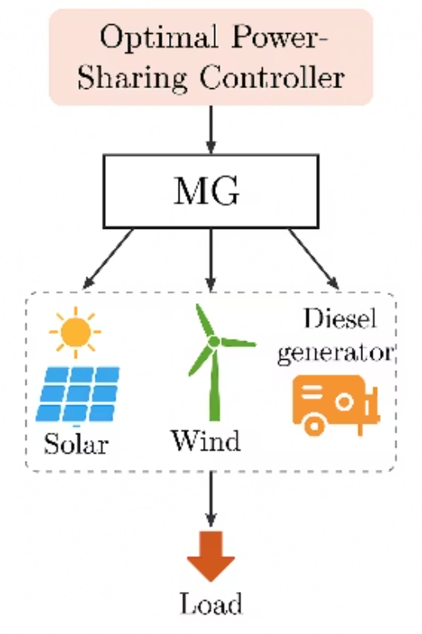
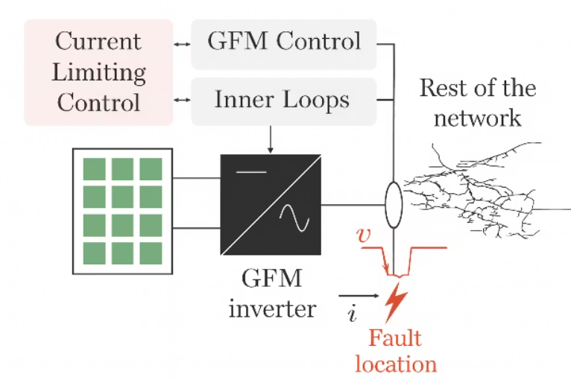
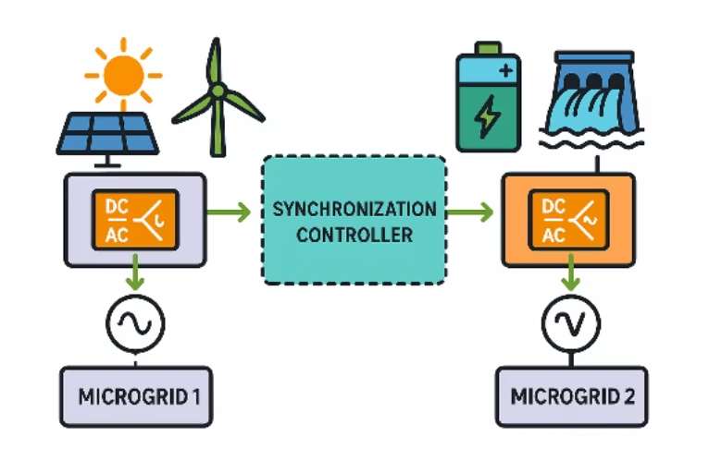
Research Objectives
The doctoral research addresses three critical challenges in microgrid control and interconnection, developing novel solutions for heterogeneous system integration, transient stability enhancement, and reliable power sharing in renewable-dominated environments.
1
2
3
Synchronization Controller for Heterogeneous Microgrids
Transient Stability Enhancement
Reliable and optimal Power-Sharing
Advanced control strategies for grid-forming converters operating under current-limiting conditions to prevent loss of synchronism during fault events and disturbances.
Innovative droop-based control mechanisms for economical and accurate power distribution among distributed generation units in renewable-rich islanded microgrids.
Design of advanced synchronization strategies capable of precisely match the incoming system synchronization parameter. The emphasis is on achieving seamless interconnection irrespective of the underlying generation technologies or control architectures..

Slide 4

Key Technical Contributions
01
02
Unified Synchronization Framework
Angle-Based Control with Enhance Transient
Stability for GFM
03
Multi-Segment Adaptive Droop for optimal/reliable power sharing
Contribution 1
Contribution 2
Contribution 3
Single PI controller for heterogeneous MG interconnection with comprehensive system modeling
Virtual power introduction in droop control activates during disturbances only
Dynamic droop adjustment based on priority and cost for accurate economic dispatch
Enhanced phase tracking prevents synchronism loss during current-limiting operation
Fuzzy logic adaptive gradient controller maintains stability within DG capacity limits
Validated through simulations and PHIL experiments for seamless synchronization
Addresses both Type 1 and Type 2 instability mechanisms in GFM inverters
Small-signal modeling framework enables systematic parameter tuning for robust performance
Droop resetting mechanism ensures stable operation and optimal power sharing post-interconnection

Slide 5
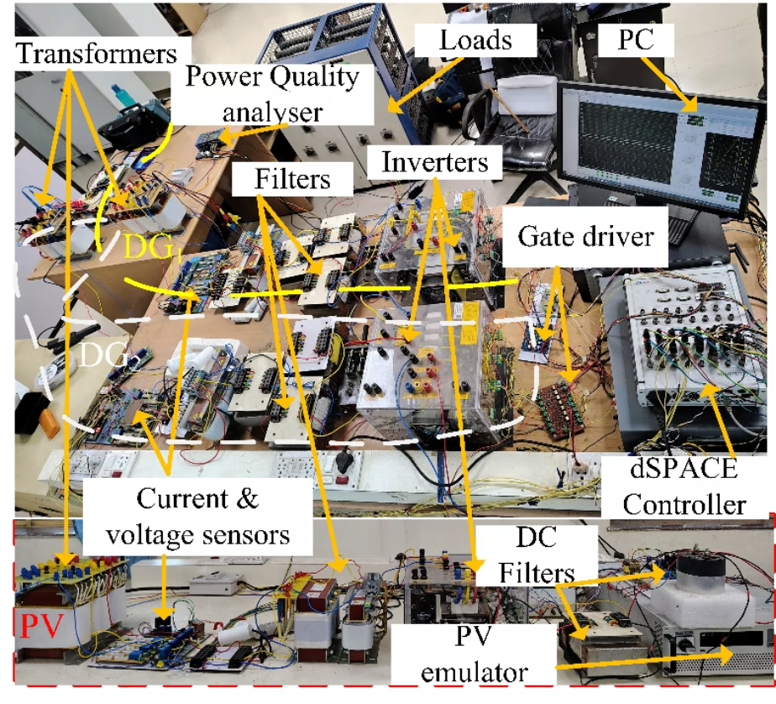
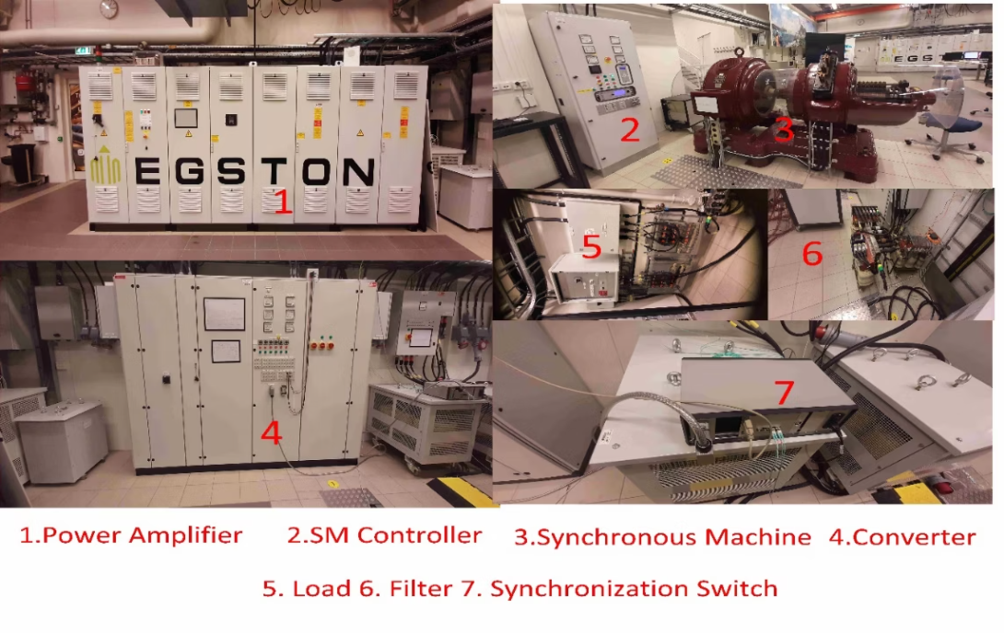
Experimental Validation Infrastructure
Power Hardware-in-the-Loop (PHIL) experimental setup at Norwegian University of Science and Technology (NTNU), Norway
Microgrid experimental testbed at Indian Institute of Technology Bhubaneswar (IITBBS), India
Real-Time Simulation
Multi-DG Configuration
Testing
Experience in Power-hardware-in-loop to validate the system for bigger setup
Development of a 20 kW hardware prototype.
2 constant voltage source based DG
PV based DG
Diesel based generator
Comprehensive disturbance analysis, including voltage sags, frequency deviations, and topology changes.

Slide 6
Research Dissemination and Impact
Journals
A. Gupta, P.C. Sekhar, "A Droop Based Unified Synchronization Scheme with Adaptive Phase and Frequency Loop Integration for Interconnection of Heterogeneous Microgrids". (1st revision completed in IEEE Transaction in Power Electronics)
A. Gupta, P.C. Sekhar, M.Z. Degefa, S. D’Arco’ "A Unified Controller for Interconnection of Heterogeneous, Multi-DG Mini/Microgrids with Varying Dynamic Characteristics". (1st revision completed in IEEE Journal of Emerging and Selected Topics in Industrial Electronics)
A. Gupta, P.C. Sekhar, "Enhanced Transient Stability Strategy for Grid-Forming Inverters Operating in Current Limiting Mode". (Communicated in IEEE Transaction in Power Electronics).
A. Gupta, P.C. Sekhar, "A Multi-Segment Adaptive Droop Control Strategy for Optimal Power Sharing in Renewable Dominated Islanded Microgrids". (To be submitted )
Conferences
A. Gupta and P. C. Sekhar,“A Sliding Mode-based Negative Sequence Compensation for Seamless Interconnection of Microgrids under Unbalanced Condition”, 2025 International Conference on Power Electronics and Energy (ICPEE), Bhubaneswar, India, 2025, pp. 1-6.
A. Gupta and P. C. Sekhar,“Dynamic Droop Control for Optimal Power Sharing in Renewable Rich Hybrid Islanded Microgrids”, 2024 IEEE International Conference on Power Electronics, Drives and Energy Systems (PEDES), Mangalore, India, 2024, pp. 1-6.
A. Gupta, P. C. Sekhar, M. Z. Degefa, K. Jonatan R. A. and S. D’Arco, "Synchronization Controller for Seamless Interconnection of Mirogrids with Heterogeneous Sources," 2022 22nd National Power Systems Conference (NPSC), New Delhi, India, 2022, pp. 344-349.
A. Gupta and P. C. Sekhar, "A Review of Control Strategies for Operation of Distributed Resources Under Grid Faults," 2022 IEEE PES Innovative Smart Grid Technologies – Asia (ISGT Asia), Singapore, Singapore, 2022, pp. 200-204.
M. Z. Degefa, J. R. A. Klemets, S. D’Arco, P. C. Sekhar and A.Gupta, "Review of Grid Interconnection Requirements and Synchronization Controllers for Dispersed Minigrids," 2021 IEEE PES/IAS Power Africa, Nairobi, Kenya, 2021, pp. 1-5.
A. Gupta and A. R. Saxena, "An Isolated Dual-Input Dual-Output DC-DC Converter with Bi-directional Feature for Low Voltage DC Grids," 2020 IEEE First International Conference on Smart Technologies for Power, Energy and Control (STPEC), Nagpur, India, 2020, pp. 1-6

Slide 7



Thank
You
Amit Gupta, PhD CandidateIndian Institute of Technology Bhubaneswar

